Slide 1
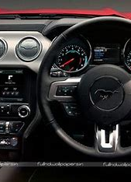
SMART driving monitoring system:
An Internet of Things-based Alerting system for tracking and identifying the Driving Behavior & Driver Drowsiness
Presented by:
Akshay Kumar
(2022MSBDA047)
Guided by:
Dr. Kapil Gupta Sir
National Institute of Technology,Kurukshatra

Slide 2
Introduction
Aim of this project is implementing the system as a prototype by capturing vehicle movements parameter, such as steering wheel movement, lane keeping, acceleration pedal movement and braking, etc. and Capturing the live images of the eyes and fed them in to the Microcontroller in Which the OpenCV PYTHON library is used to process the video and convert it in to frames and process it accordingly. Some customized algorithms are coded in PYTHON library for images segmentation of eyes from the entire image and image recognition of the eyes and face position.
Vehicle movements: Sharp turns, sudden acceleration, and braking can all indicate aggressive driving or a distracted driver.
Driver monitoring: Cameras can track facial expressions, eye gaze, and head position to gauge alertness and potential distraction.
By analyzing this data, driving behavior detection systems can aim to identify:
Dangerous behaviors: Distracted driving, drowsiness, and aggression are all major causes of accidents.
Inefficient driving: Harsh acceleration and braking can waste fuel and increase wear on the vehicle.

Slide 3
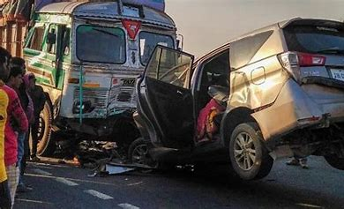
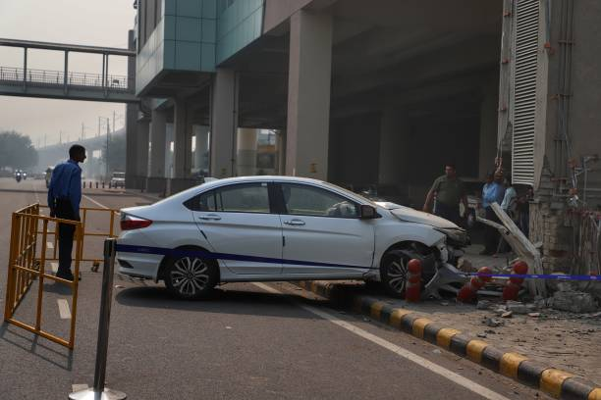
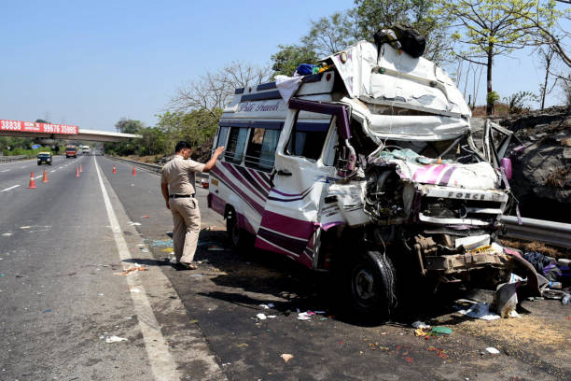
OBJECTIVE
Nowadays the driver safety in the car is one of the most wanted system to avoid accident. Our objective of the project is to ensure the safety system. For enhancing the safety.I am detecting the driver behavior, eye blinks of the driver and estimating the driver status and control the car accordingly.I will alert driver

Slide 4
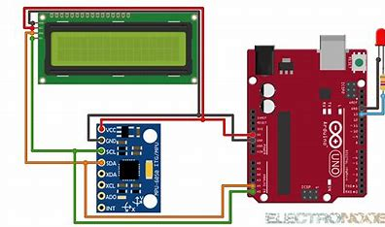
electronic components for driving behavior detection & alert

Slide 5
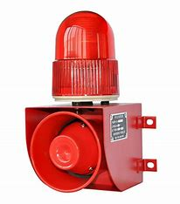
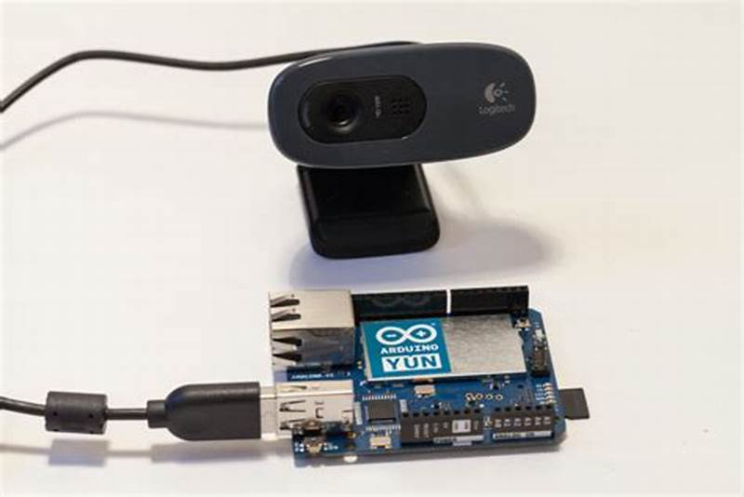
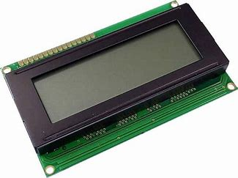
electronic components for driver Drowsiness detection & Alert

Slide 6
Methodology(a)
Data Collection:
Gather data from various sensors and sources such as:
In-vehicle sensors (e.g., steering angle, acceleration, brake pressure)
Vision-based sensors (e.g., cameras facing the driver's face and the road)
I have Collected labeled data from kaggle indicating different states of driver behavior (e.g., alert, drowsy, distracted).
Preprocessing using python library (pandas and numpy):
Clean and preprocess the collected data to remove noise and inconsistencies.
Normalize and scale the data to ensure uniformity across different features.

Slide 7
Methodology(b)
Feature Extraction:
Extract relevant features from the collected data that are indicative of driver drowsiness and behaviors.
Features may include eye blink frequency, facial expressions, head movements, steering patterns, lane deviations, etc.
Model Training:
Utilize machine learning algorithms to train models on the extracted features.
Machine Learning classifications techniques such as (Decision Trees,Random Forest,Support Vector Machines (SVM),k-Nearest Neighbors (k-NN),Gradient Boosting Machines (GBM),Neural Networks (e.g., CNNs, RNNs)
Train separate models for detecting drowsiness and different behaviors (e.g., distracted driving, aggressive driving).

Slide 8
Methodology (c)
Model Evaluation:
Evaluate the trained models using validation data to assess their performance.
Metrics such as accuracy, precision, recall, and F1-score can be used to measure model performance.
Integration:
Integrate the trained models into a real-time system that continuously monitors driver behavior.
Develop algorithms to combine outputs from multiple models for comprehensive behavior detection.

Slide 9
Milestones achieved
Deployment:
Deploy the system in vehicles or as part of advanced driver assistance systems (ADAS).
Ensure the system's compatibility with different vehicle types and environments.
Feedback and Improvement:
Gather feedback from the deployed system and users to identify areas for improvement.
Continuously update and refine the models based on new data and insights.

Slide 10
Future plans
This program can use for Aircraft Also
Make Easy Drive
Develop Auto-Driving system
Reduce Cost
High Security

Slide 11
REFERENCES
[1] P. Alvarez, I. Lerga, A. Serrano, J. Faulin, Considering congestion costs and driver
behaviour into route optimisation algorithms in smart cities. Lecture Notes in
Computer Science (Including Subseries Lecture Notes in Artificial Intelligence and
Lecture Notes in Bioinformatics), Springer Verlag, 2017, pp. 39–50, https://doi.
org/10.1007/978-3-319-59513-9_5.
[2] H. Singh, A. Kathuria, Analyzing driver behavior under naturalistic driving
conditions: a review, Accid. Anal. Prev. 150 (2021), https://doi.org/10.1016/j.
aap.2020.105908.
[3] L. Sun, Z. Lin, W. Li, Y. Xiang, Freeway incident detection based on set theory and
short-range communication, Transp. Lett. Lett. 11 (2019) 558–569, https://doi.org/
10.1080/19427867.2018.1453273.

